Slide 1
History

Slide 2
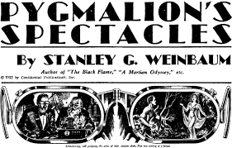
1930s - Stanley G. Weinbaum
First proposed the idea of virtual reality in his short story Pygmalion’s Spectacles written in the 1930s

Slide 3
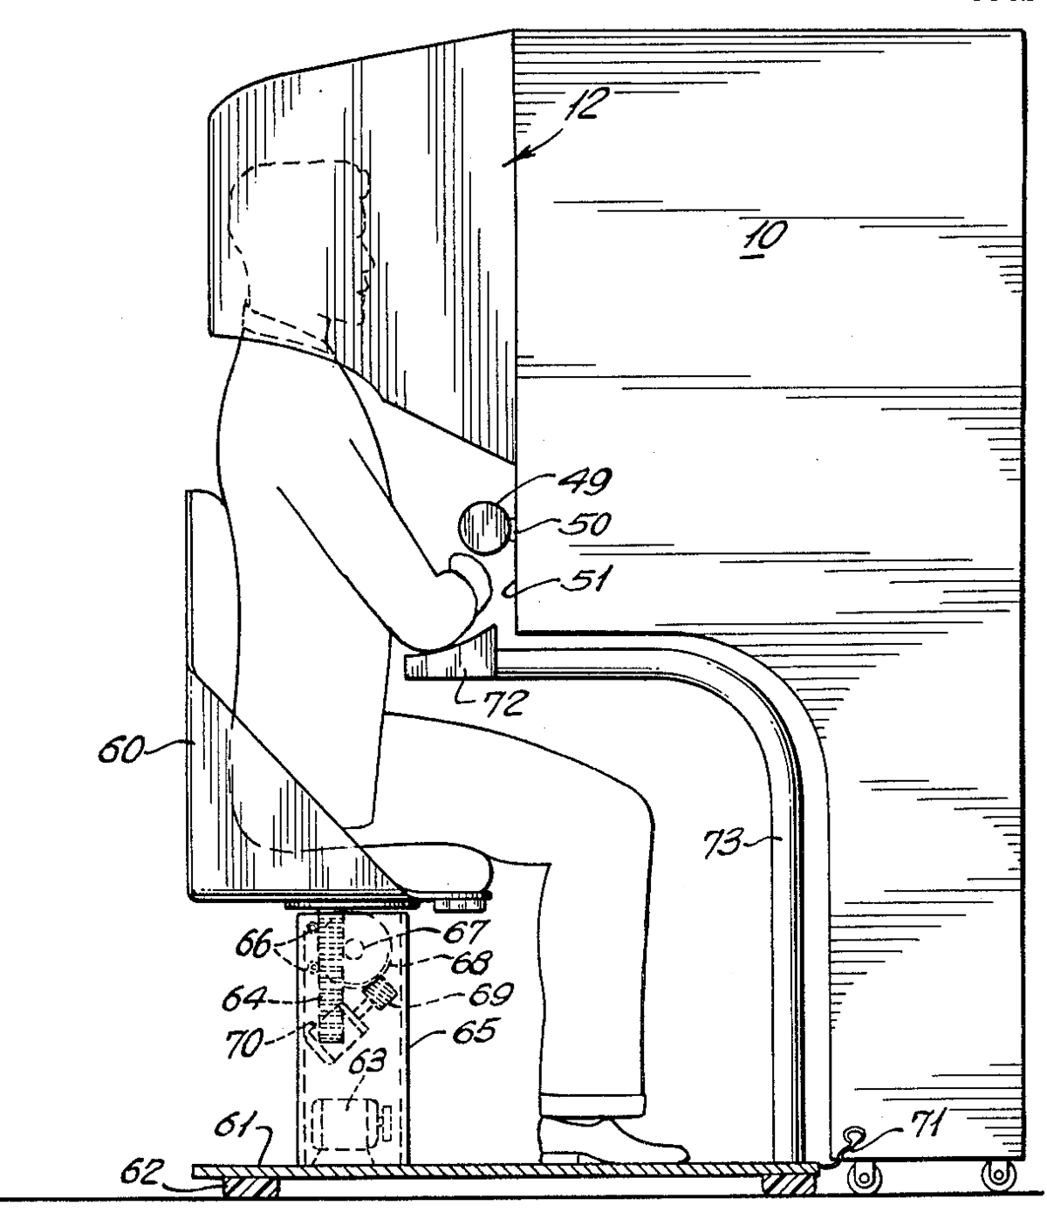
1955 – Morton Heilig
Heilig envisioned a multi-sensory theatre in his paper entitled “The Cinema of the future”

Slide 4
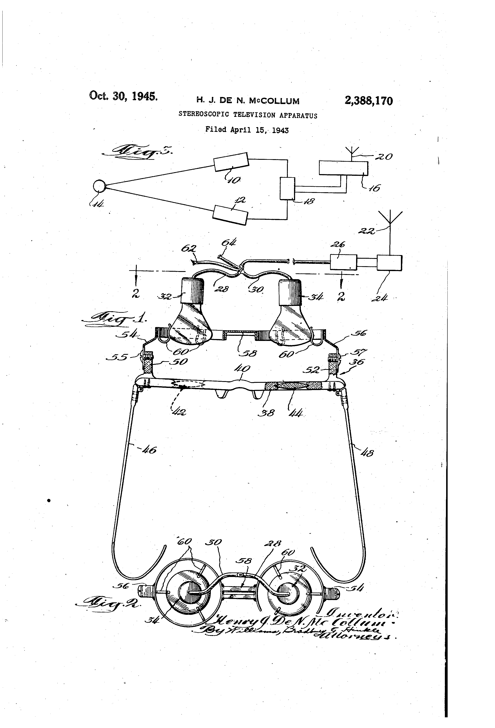
1960 – Morton Heilig
Patented a design in 1960 called The Sword of Damocles and it is considered the first virtual reality head-mounted display.

Slide 5
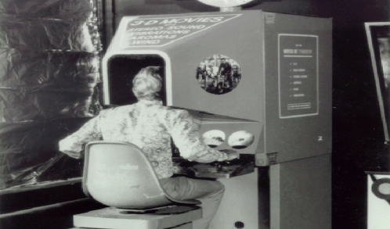
1962 - Morton Heilig
Created the Sensorama, one of the earliest known examples of a virtual reality systems.

Slide 6
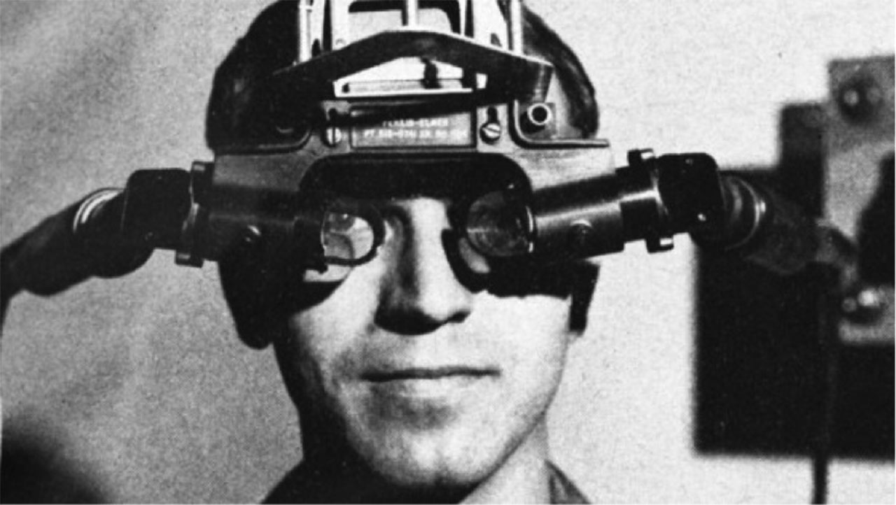
1965 - Ivan Sutherland
The Ultimate display

Slide 7
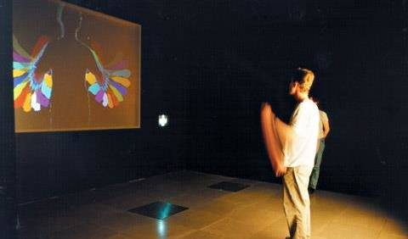
1970s - Myron Krueger
Created Videoplace this was an artificial reality that surrounded the user, it also responded to their movements without needing goggles or gloves, the user would be projected onto a screen in front of them, they could change the image of themselves by moving around.

Slide 8
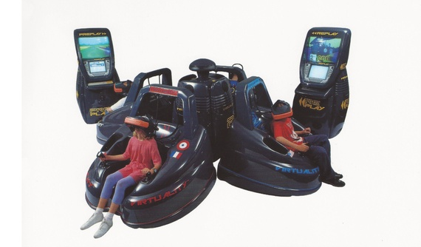
1991 - Virtuality Group
VR arcade games

Slide 9
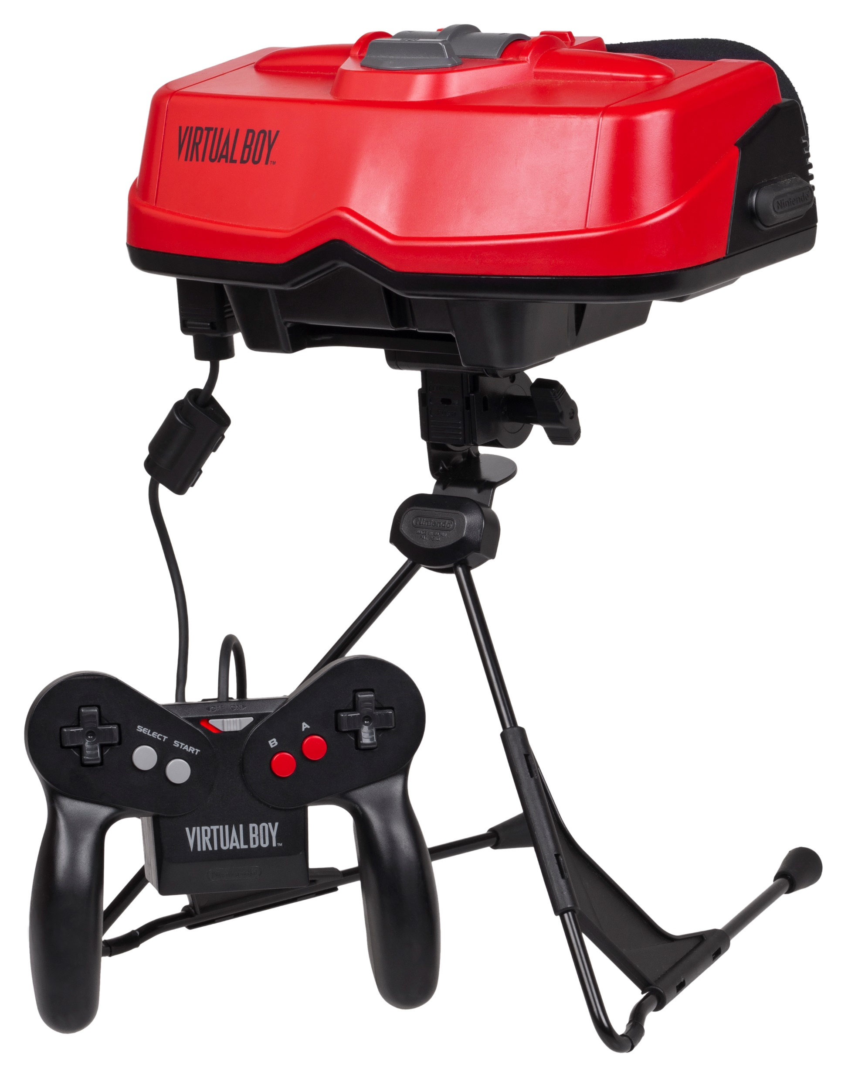
1995 - Nintendo Visual Boy
Head mounted display and “3D” graphics.

Slide 10
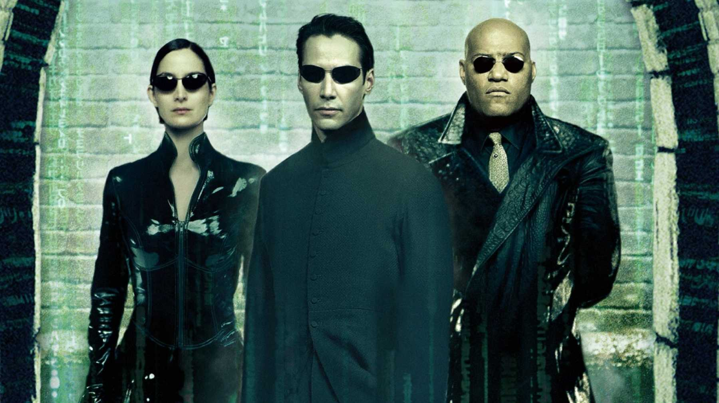
1999 - The Matrix
Inspired people to invest in VR.

Slide 11
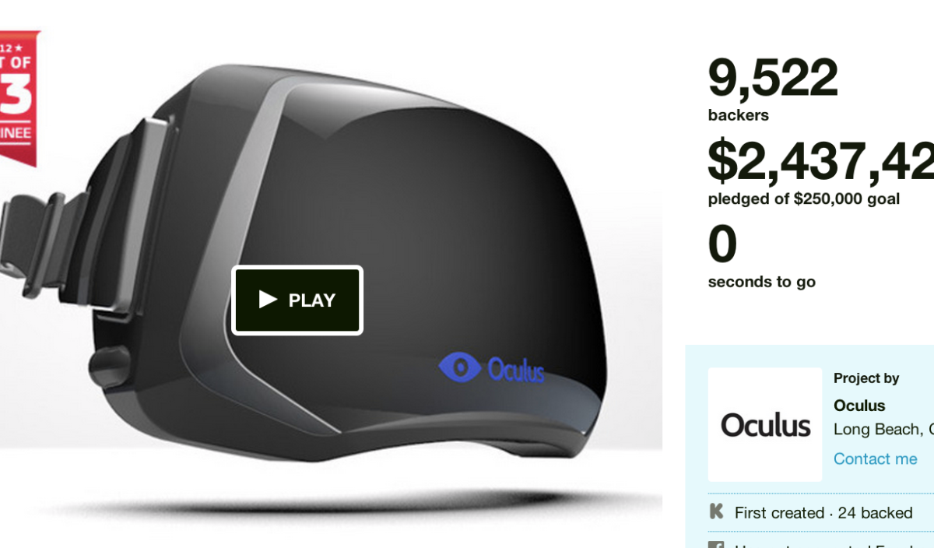
2012 - Oculus
Kickstarter raises 2.5 million and essentially influenced most of the large tech companies to create the VR technology that we see today.

Slide 12
Future of VR

Slide 13
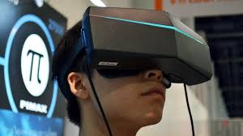
Pimax 8k Headset
Provides a more captivating experience, but requires a very powerful processor.

Slide 14
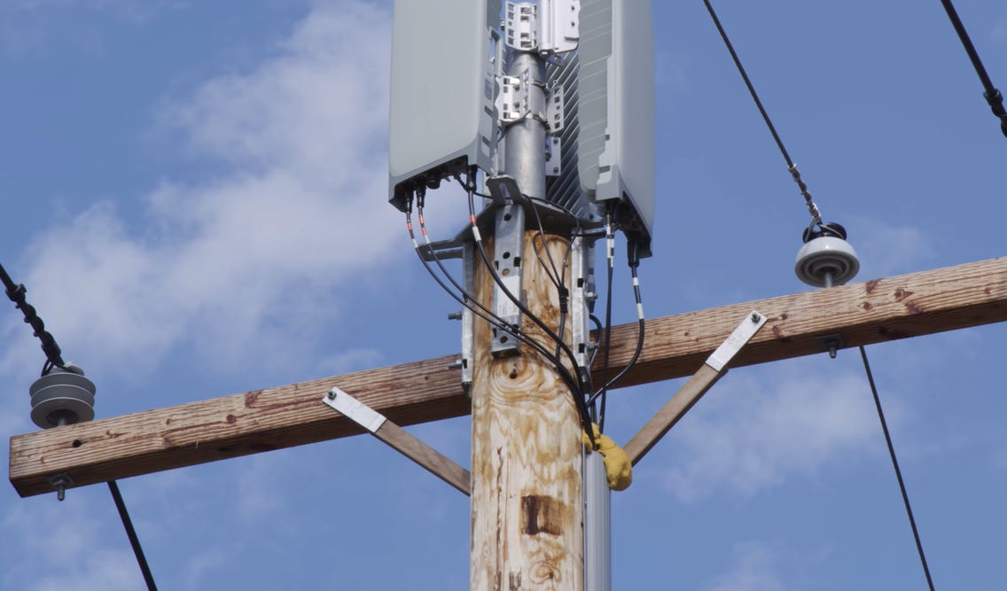
Developments in 5G
VR could potentially receive images in real time

Slide 15
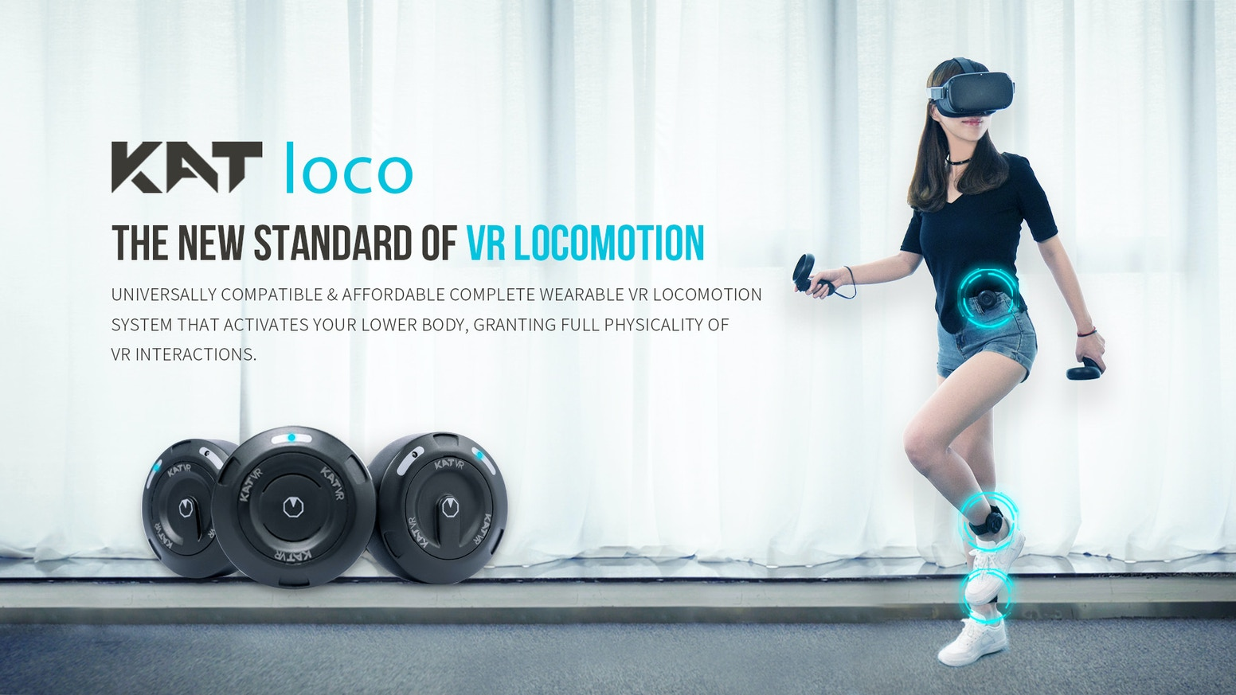
KAT VR
Complete control over lower body

Slide 16
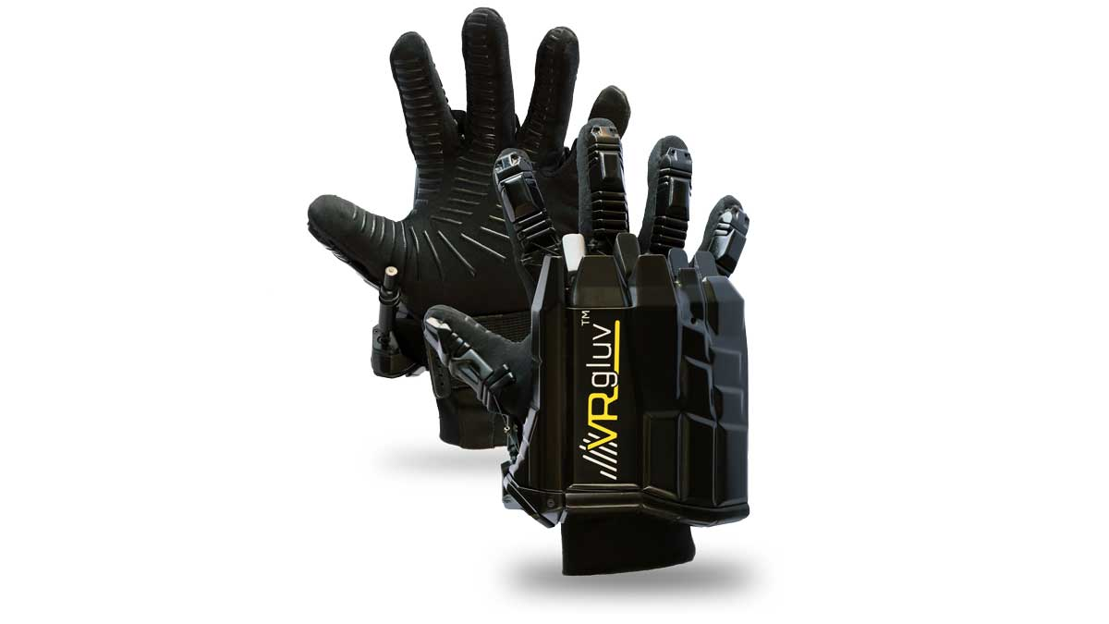
VRGluv
Haptic gloves, big and clunky. Also quite expensive.

Slide 17
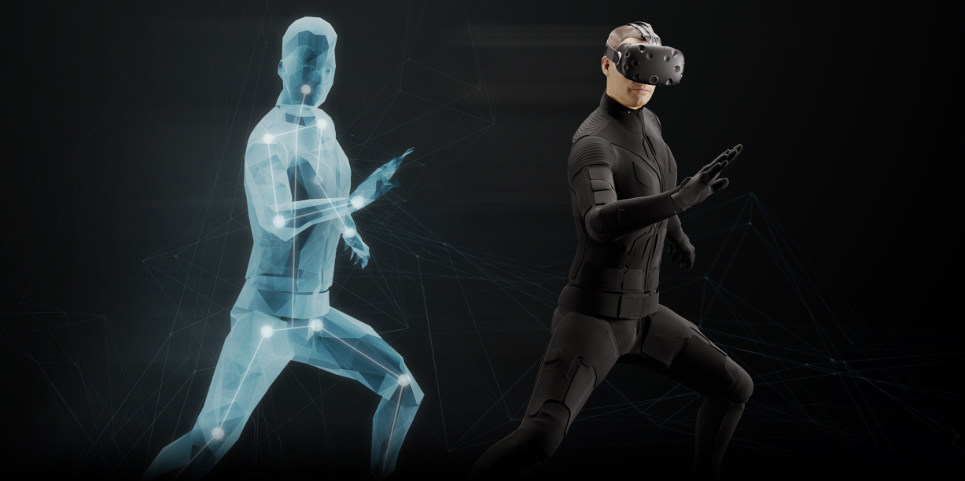
Tesla Suit
Full body haptic suit, not easily available to the public yet

Slide 18
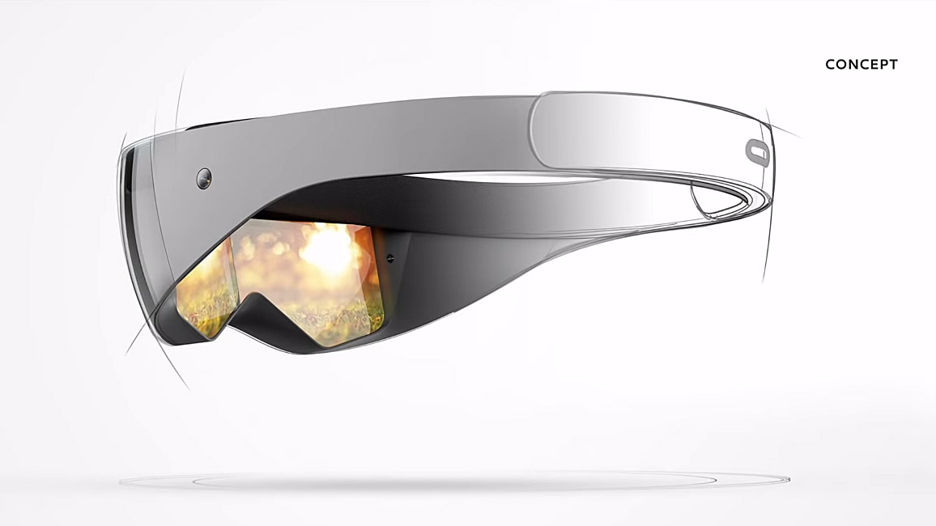
Future VR headsets
Right now the headsets are heavy and large. It is hoped that VR headsets will be light and easy to ignore when wearing them.

Slide 19
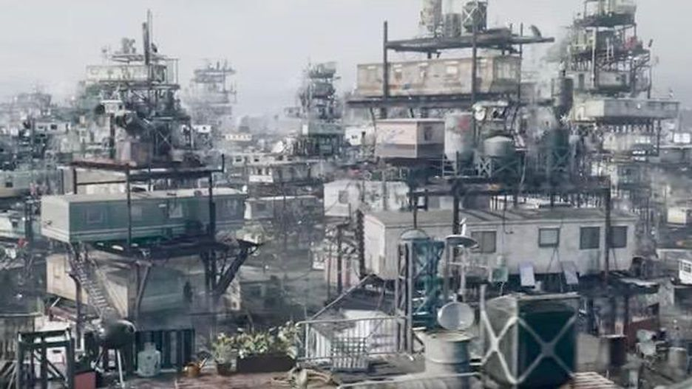
Ready Player One
One can only hope we avoid the dystopian future detailed in the 2018 movie Ready Player One where humanity lives in a virtual world in order to escape the bleakness of our own world.

